Slide 1

“Raindrops Keep Falling on My Head”
Krisma King

Slide 2

About Me. . .
Originally from Miami, Florida and now live in Miramar, Florida
Bachelor’s in psychology from FIU and an associate degree in English from Valencia
Co-leader of a small group at my church
Have been working in retail and currently a cashier at Lowe’s

Slide 3
Project info
Interest in climate change was piqued with the United States rejoining the Paris climate agreement earlier this year
The United Nations states that climate change “refers to long-term shifts in temperatures and weather patterns”
One of the many “shifts” is unpredictable water availability
This led to the question “What impact has climate change had on available water?”

Slide 4
Project info
Data on clean water including climate change was mostly government protected or unavailable for free use
While searching for more data, an article from 2019 on USAToday.com titled, “These American cities will soon be under water” emerged
The article named Miami Beach, Florida number one out of thirty-five cities
Cities were ranked by the number of residents living in parts of the community “expected to be regularly flooded by 2060.”

Slide 5
Project info
Miami Beach is 30 minutes from presenter’s home city and 37 minutes from current residence
Focus turned to Miami and the rate at which it was flooding since Florida is prone to hurricanes, flooding and other water related disasters
One of the causes of flooding and other disasters is heavy thunderstorms
All of this led to the final question of “How have precipitation levels changed in Miami, FL?”

Slide 6
Data source requirements:
Had to be in the right format
Not previously cleaned
Had recent data
Have labeled data

Slide 7
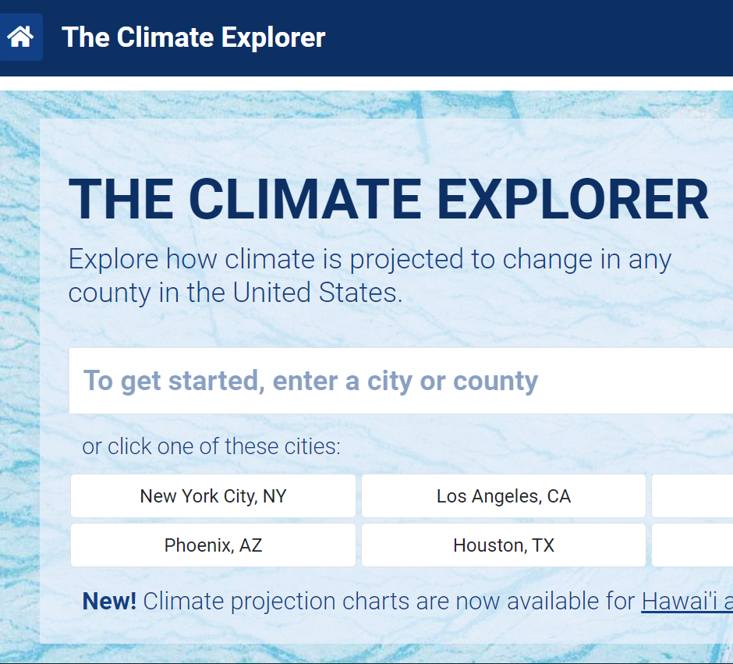
Main Data source
The Climate Explorer
A tool that allows users to check past and future climate conditions in the United States
There is also ongoing data on historical weather collected from individual climate and weather stations
The data is shown as an interactive graph and is also downloadable

Slide 8
Additional data source
The National Weather Service
Information on Florida’s weather
Southeast Florida is characterized by two predominant seasons-- summer and winter
Also, “showers and thunderstorms is almost a daily occurrence during the summer”
And information on a U.S. 30-year normal in relation to the data

Slide 9
Data note. . .
The sample size was from the year 1938 to 2020
The ‘Precipitation’ column shows the actual count of inches of precipitation that has fallen for each recorded year
The ‘Precipitation_normal’ column shows the Climate Normals for precipitation.
The National Weather Service describes a “normal” of a specific variable as the 30-year average
Used to calculate the expected counts for future years

Slide 10
Methods
Jupyter Notebook with Pandas was used for data wrangling
The year and month of the ‘date’ column had to be separated
The data had many NaN variables that had to be removed
The first and last years had to be removed due to missing data
Jupyter Notebook with matplotlib and Tableau were used to create graphs
Graph the number of days there was precipitation and the total number of inches that fell

Slide 11
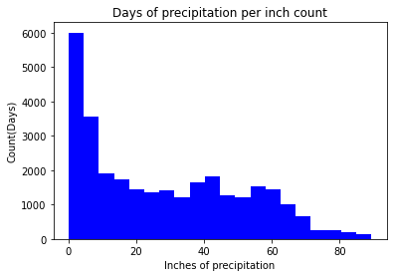
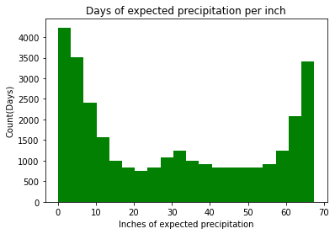

Slide 12
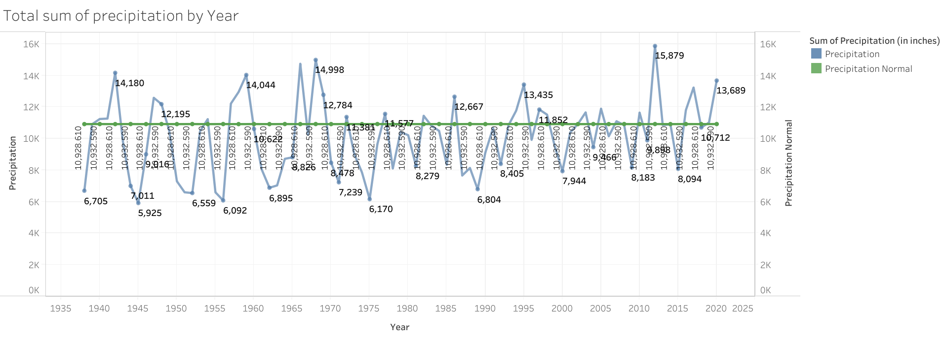

Slide 13
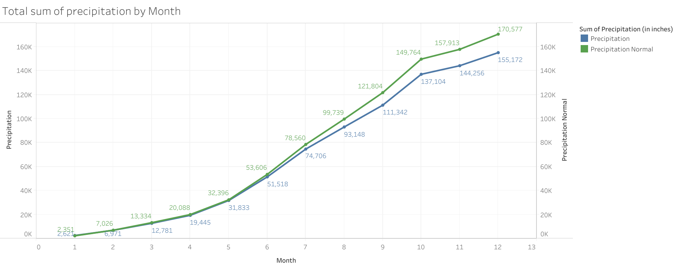

Slide 14
Results
Expected precipitation levels are rarely matching up to the amount of precipitation Miami receives
For each month, the precipitation count is lower than expected later in the year but in the beginning the counts are close
The lower counts of precipitation per year are growing as are the larger counts
The number of days in the sample size receiving (and not receiving) precipitation was greater than the expected

Slide 15
Summary
In Miami there is an increase in precipitation compared to previous years
There are more days where residents are seeing precipitation and the aftereffects of it
Due to the dominant seasons of Florida, there are more months where precipitation may occur and have the potential to cause damage
A 30-year time span may be too large a variable to yield accurate predictions for what Miami residents can expect with precipitation levels

Slide 16
Conclusions
How do your findings impact the world at large?
Precipitation levels affect nearly every facet of life. If the levels continue to increase unpredictably and there are no steps in place to prevent the scales from tipping, destruction of crops, homes, businesses, and more is imminent
What's important about this work?
It sounds an alarm that action must take place to mandate the uncovering and addressing of the factors that contribute to climate change
Big picture information
There needs to be more focus on clean water and climate changes impact on precipitation in the U.S.

Slide 17
Cited Information
Climate Program Office, N. O. A. A. (2021). Climate explorer. Climate Explorer. Retrieved October 29, 2021, from https://crt-climate-explorer.nemac.org/.
Mai, H. J. (2021, February 19). U.S. officially rejoins Paris Agreement on climate change. NPR. Retrieved October 29, 2021, from https://www.npr.org/2021/02/19/969387323/u-s-officially-rejoins-paris-agreement-on-climate-change.
Sauter, M. B., & Frohlich, T. C. (2019, June 18). These American cities will soon be under water. USA Today. Retrieved October 29, 2021, from https://www.usatoday.com/story/money/2019/06/18/climate-change-american-cities-that-will-soon-be-under-water/39533119/.
US Department of Commerce, N. O. A. A. (2021, May 4). New 1991-2020 climate normals. National Weather Service. Retrieved October 29, 2021, from https://www.weather.gov/tbw/newnormals.

Slide 18
Questions?

